Slide 1
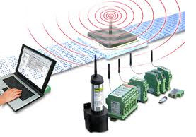
Chapter 1
Introduction
Data Communication
Networks
Protocols and Standards
Standard Organizations

Slide 2
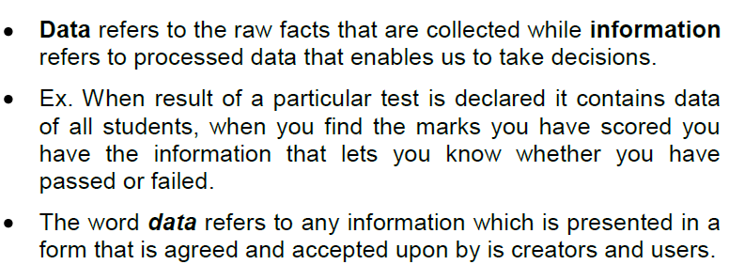
Data and Information

Slide 3
Data Communication
Data Communication is a process of exchanging data or information
In case of computer networks this exchange is done between two devices over a transmission medium.
This process involves a communication system which is made up of hardware and software. The hardware part involves the sender and receiver devices and the intermediate devices through which the data passes. The software part involves certain rules which specify what is to be communicated, how it is to be communicated and when. It is also called as a Protocol.

Slide 4
Characteristics of Data Communication
The effectiveness of any data communications system depends upon the following four fundamental characteristics:
1. Delivery: The data should be delivered to the correct destination and correct user.
2. Accuracy: The communication system should deliver the data accurately, without introducing any errors. The data may get corrupted during transmission affecting the accuracy of the delivered data.
3. Timeliness: Audio and Video data has to be delivered in a timely manner without any delay; such a data delivery is called real time transmission of data.
4. Jitter: It is the variation in the packet arrival time. Uneven Jitter may affect the timeliness of data being transmitted.

Slide 5
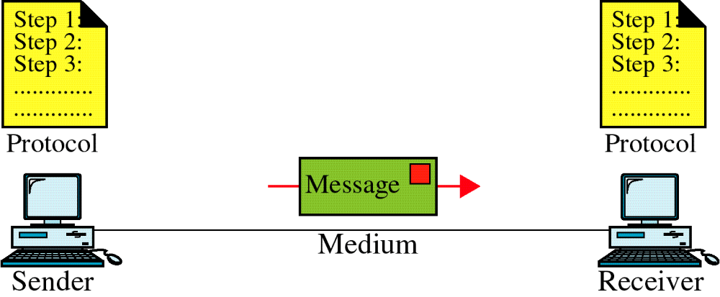
Data Communication System Components

Slide 6
Components of a Data Communication System
1. Message: Message is the information to be communicated by the sender to the receiver.
2. Sender: The sender is any device that is capable of sending the data (message).
3. Receiver: The receiver is a device that the sender wants to communicate the data (message).
4. Transmission Medium: It is the path by which the message travels from sender to receiver. It can be wired or wireless and many subtypes in both.
5. Protocol:
  It is an agreed upon set or rules used by the sender and receiver to communicate data.
  A protocol is a set of rules that governs data communication.
  A Protocol is a necessity in data communications without which the communicating entities are like two persons trying to talk to each other in a different language without know the other language.

Slide 7
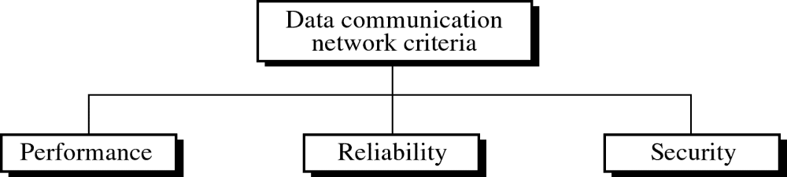

Slide 8
Basic Concepts
Line Configuration
Topology
Transmission Mode
Categories of Networks
Internetworks

Slide 9
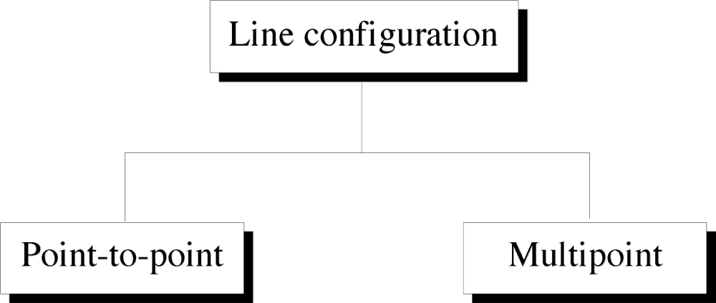

Slide 10
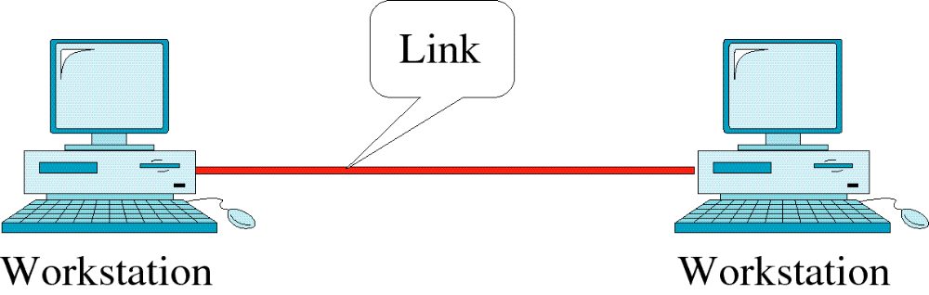
Point-to-Point Line Configuration

Slide 11
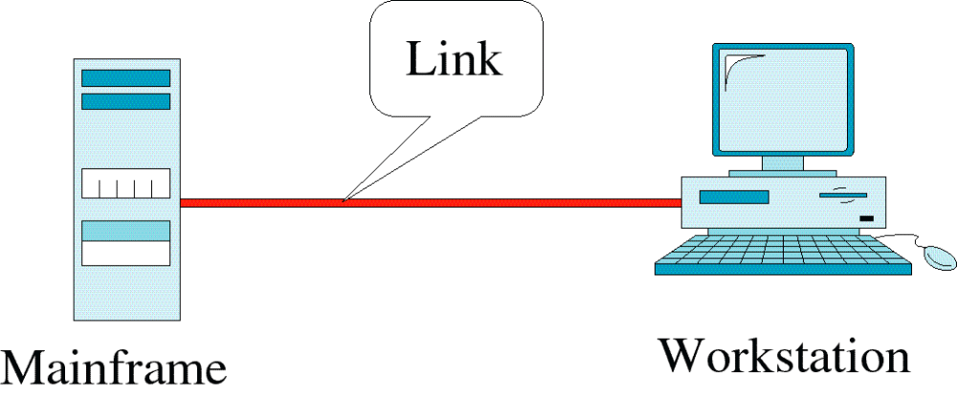
Point-to-Point Line Configuration

Slide 12
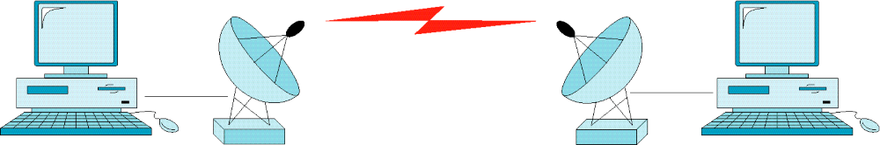
Point-to-Point Line Configuration

Slide 13
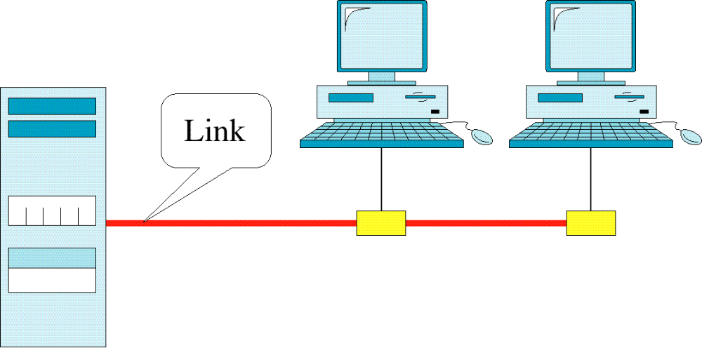
Multipoint Line Configuration

Slide 14
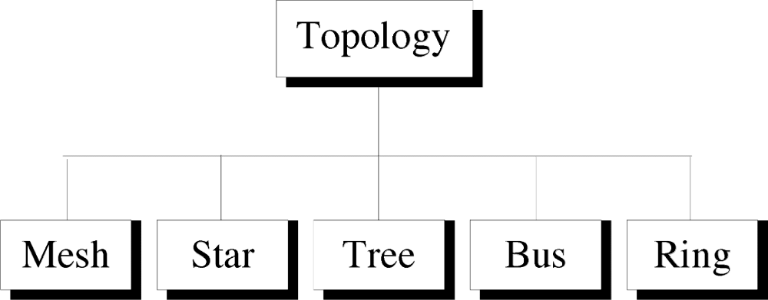
Topology
Physical and logical network layout
– Physical – actual layout of the computer cables and other network devices
– Logical – the way in which the network appears to the devices that use it.
Common topologies: – Bus, ring, star, mesh and wireless

Slide 15
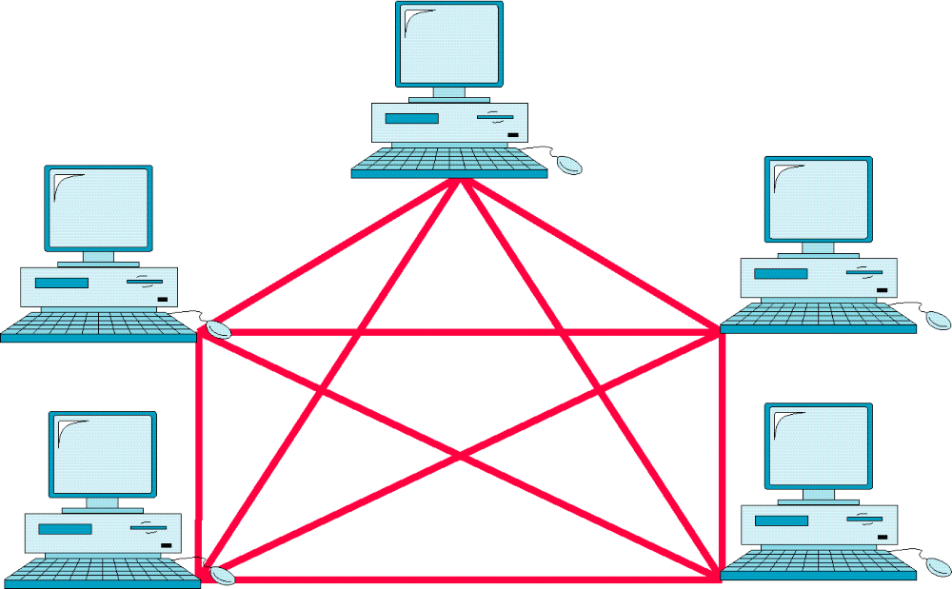
Mesh Topology

Slide 16
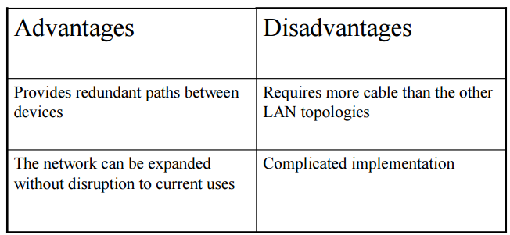
Mesh Topology
• Each computer connects to every other.
• High level of redundancy.
• Rarely used. – Wiring is very complicated
– Cabling cost is high
– Troubleshooting a failed cable is tricky
– A variation hybrid mesh
– create point to point connection between specific network devices, often seen in WAN implementation.

Slide 17
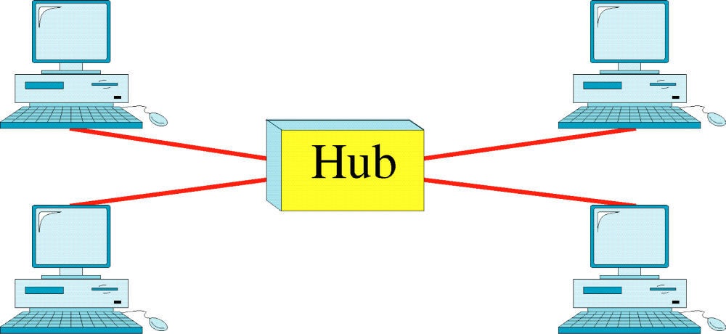
Star Topology

Slide 18
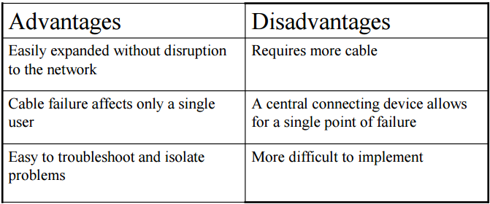
Star Topology
• All computers/devices connect to a central device called hub or switch.
• Each device requires a single cable
• point-to-point connection between the device and hub.
• Most widely implemented
• Hub is the single point of failure

Slide 19
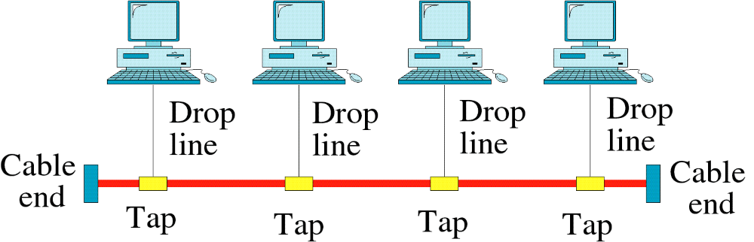
Bus Topology

Slide 20
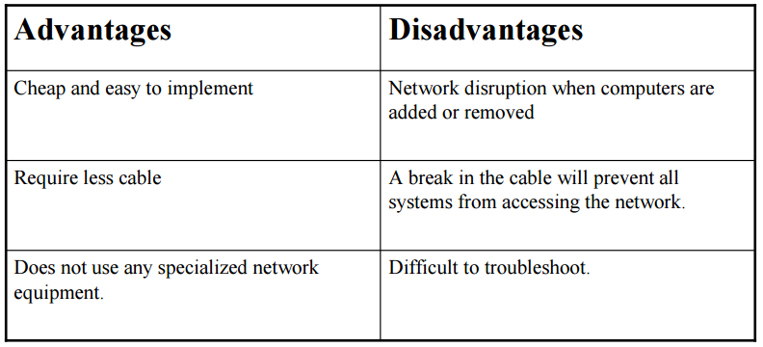
Bus Topology
• Uses a trunk or backbone to which all of the computers on the network connect.
• Systems connect to this backbone using T connectors or taps.
• Coaxial cablings ( 10Base-2, 10Base5) were popular options years ago.

Slide 21
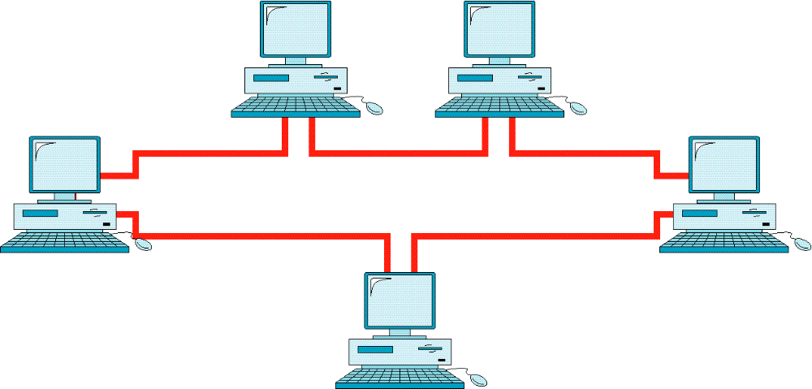
Ring Topology

Slide 22
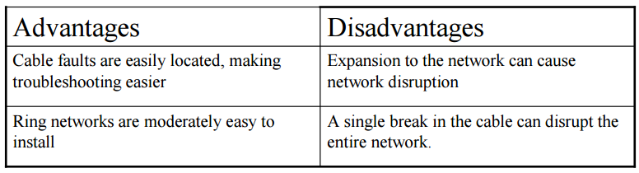
Ring Topology
Logical ring
– Meaning that data travels in circular fashion from one computer to another on
the network.
– Typically FDDI, SONET or Token Ring technology are used to implement a
ring network
– Ring networks are most commonly wired in a star configuration
• Token Ring has Multi-Station Access Unit (MSAU), equivalent to hub or switch. MSAU performs the token circulation internally.

Slide 23
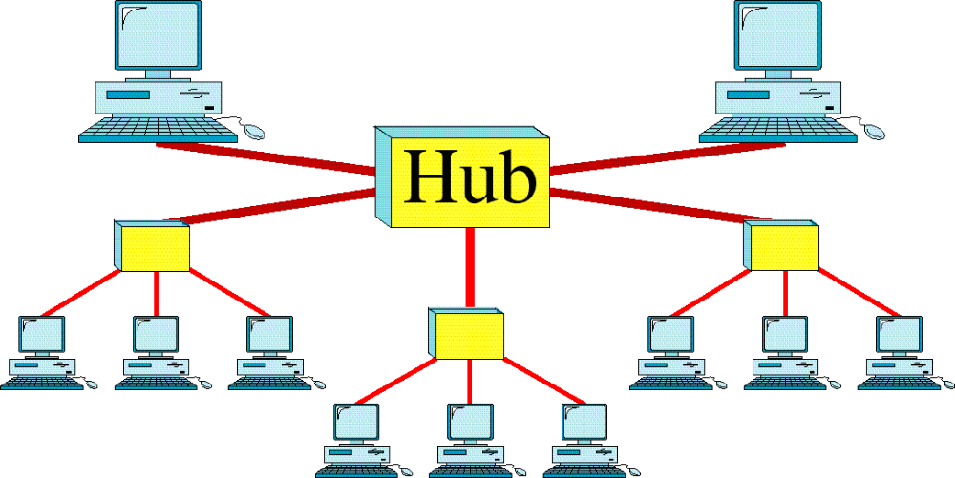
Tree Topology

Slide 24
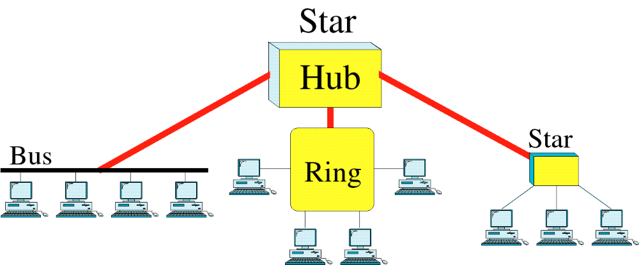
Hybrid Topology

Slide 25
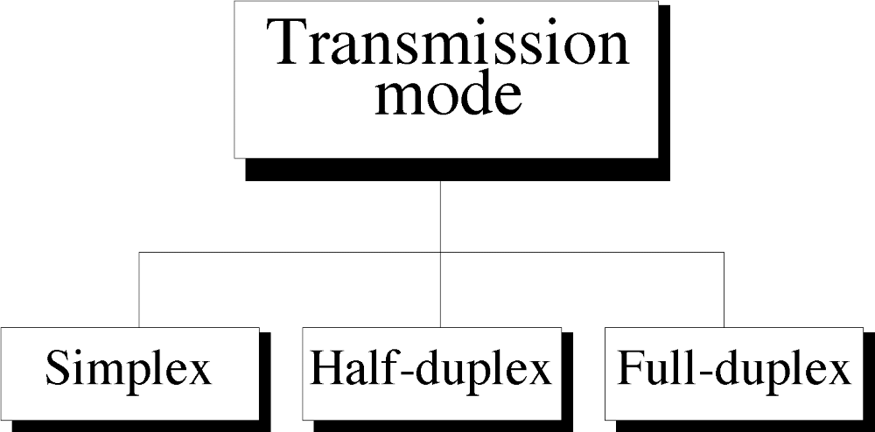

Slide 26
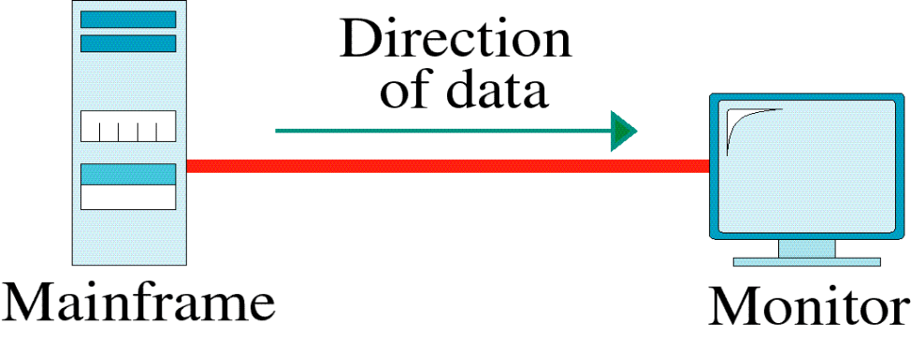
Simplex
In Simplex, communication is unidirectional
Only one of the devices sends the data and the other one only receives the data.
Example: in the above diagram: a CPU send data while a Monitor only receives data.

Slide 27
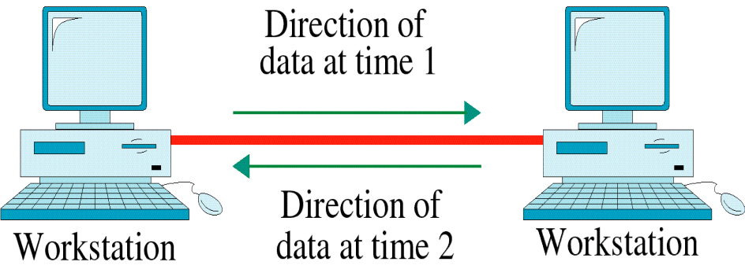
Half-Duplex
In half duplex both the stations can transmit as well as receive but not at the same time.
When one device is sending other can only receive and vice-versa (as shown in figure above.)
Example: A walkie-talkie.

Slide 28
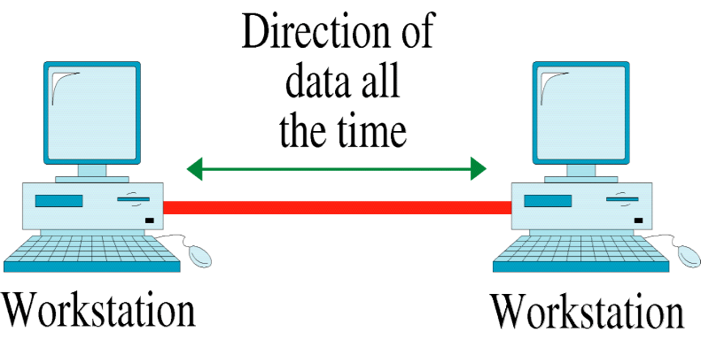
Full-Duplex
In Full duplex mode, both stations can transmit and receive at the same time.
Example: mobile phones

Slide 29
Computer Networks
Computer Networks are used for data communications
Definition:
A computer network can be defined as a collection of nodes. A node can be any device capable of transmitting or receiving data. The communicating nodes have to be connected by communication links.
A Compute network should ensure
reliability of the data communication process,
security of the data
performance by achieving higher throughput and smaller delay times

Slide 30
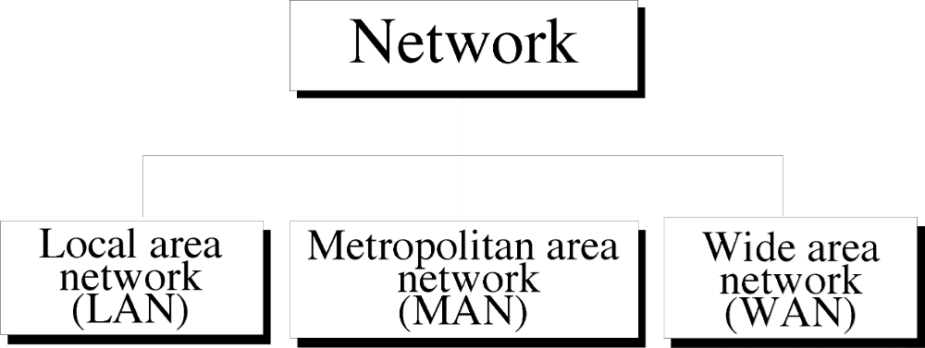

Slide 31
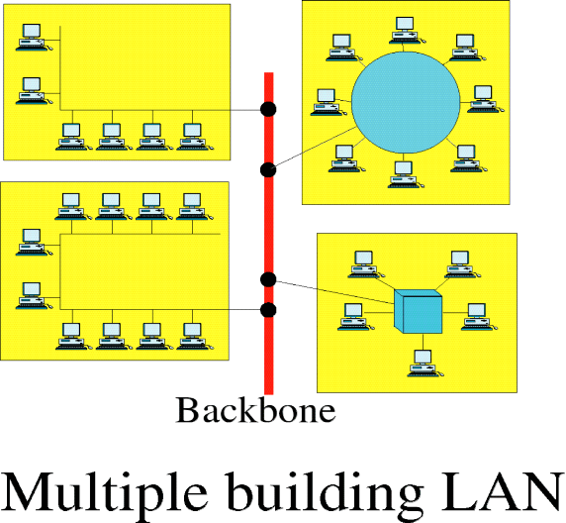
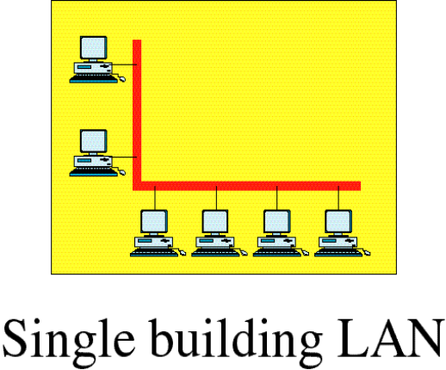
Local Area Network
Local Area Networks (LAN) is usually limited to a few kilometers of area. It may be privately owned and could be a network inside an office on one of the floor of a building or a LAN could be a network consisting of the computers in a entire building.

Slide 32
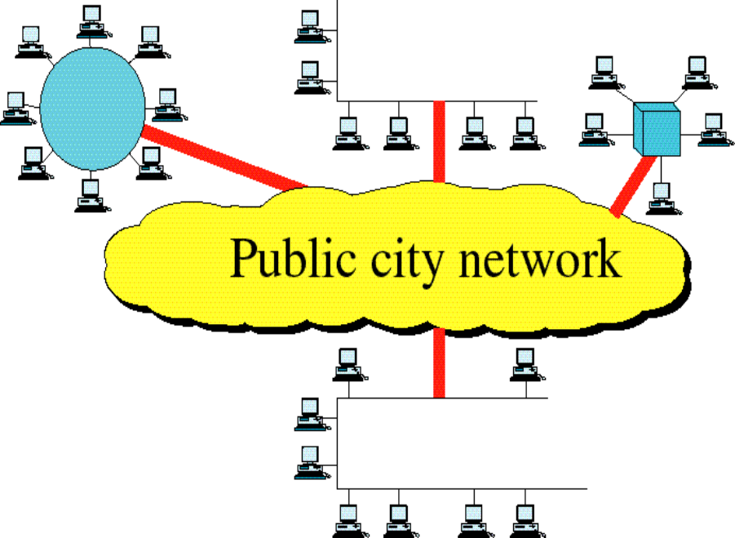
Metropolitan Area Network
Metropolitan Area Network (MAN) is of size between LAN & WAN. It is larger than LAN but smaller than WAN. It may comprise the entire network in a city like Mumbai.

Slide 33
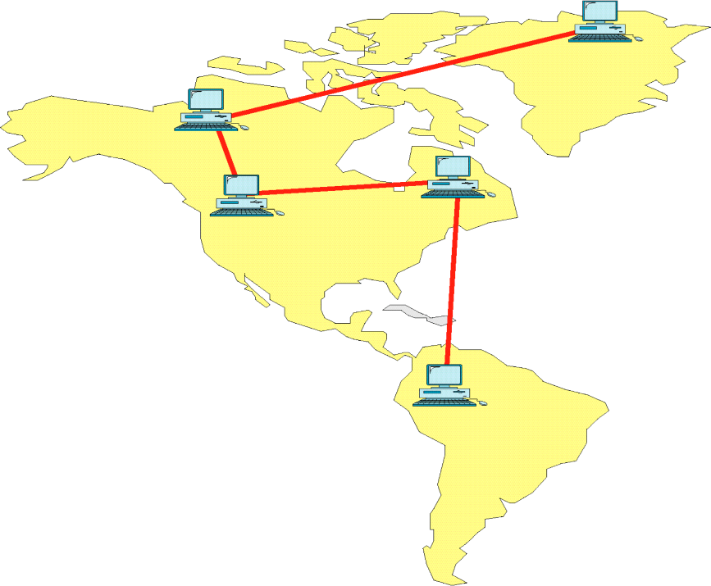
Wide Area Network
Wide Area Network (WAN) is made of all the networks in a (geographically) large area. The network in the entire state of Maharashtra could be a WAN

Slide 34
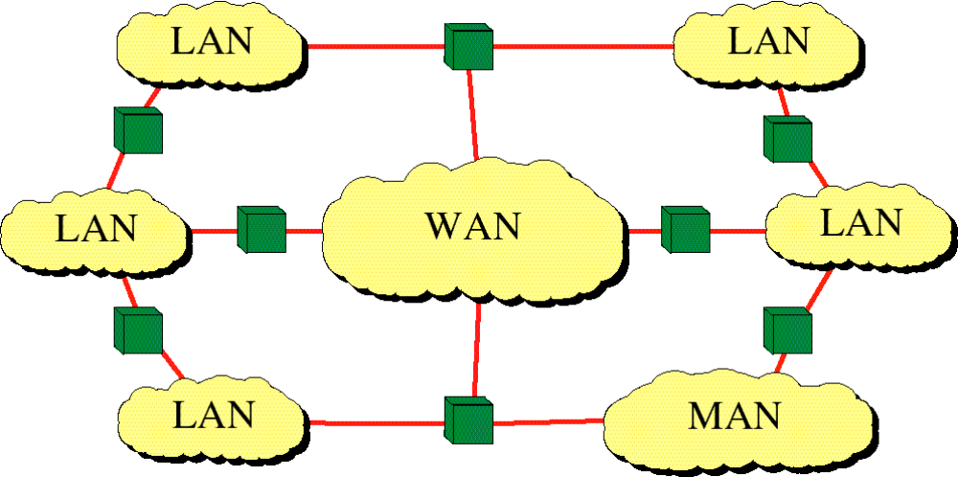
Internetwork
(Internet)

Slide 35
Uses of Computer Networks
  Business Applications
  Home Applications
  Mobile Users
  Social Issues

Slide 36
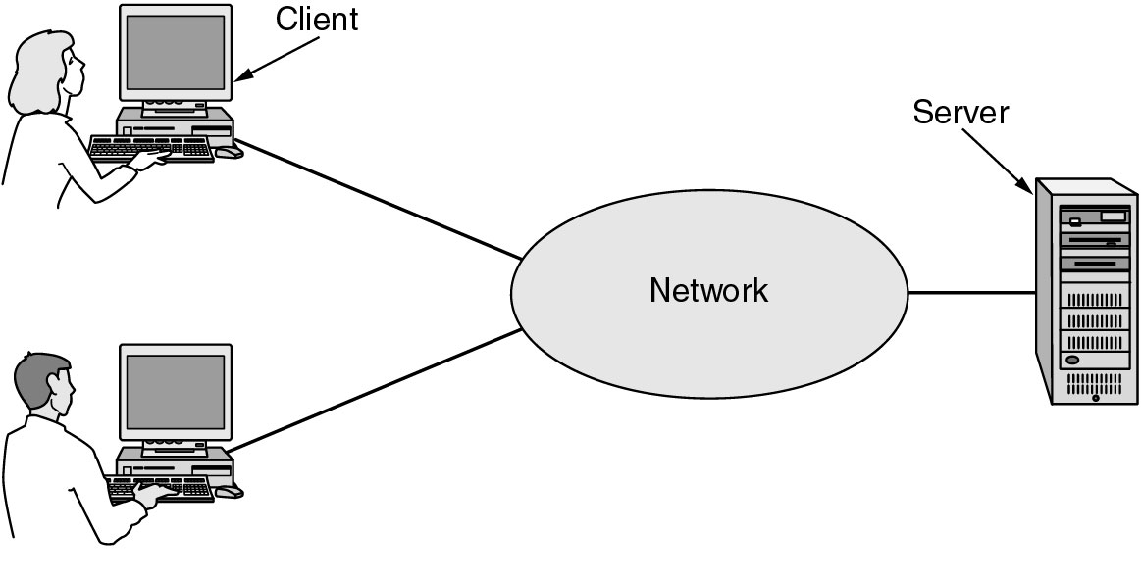
Business Applications of Networks
A network with two clients and one server.

Slide 37
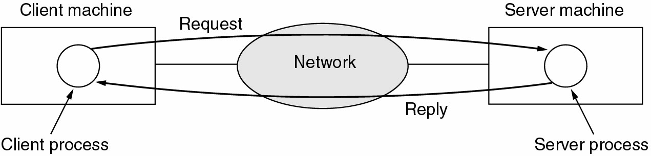
Business Applications of Networks (2)
The client-server model involves requests and replies.

Slide 38
Home Network Applications
Access to remote information
Person-to-person communication
Interactive entertainment
Electronic commerce

Slide 39
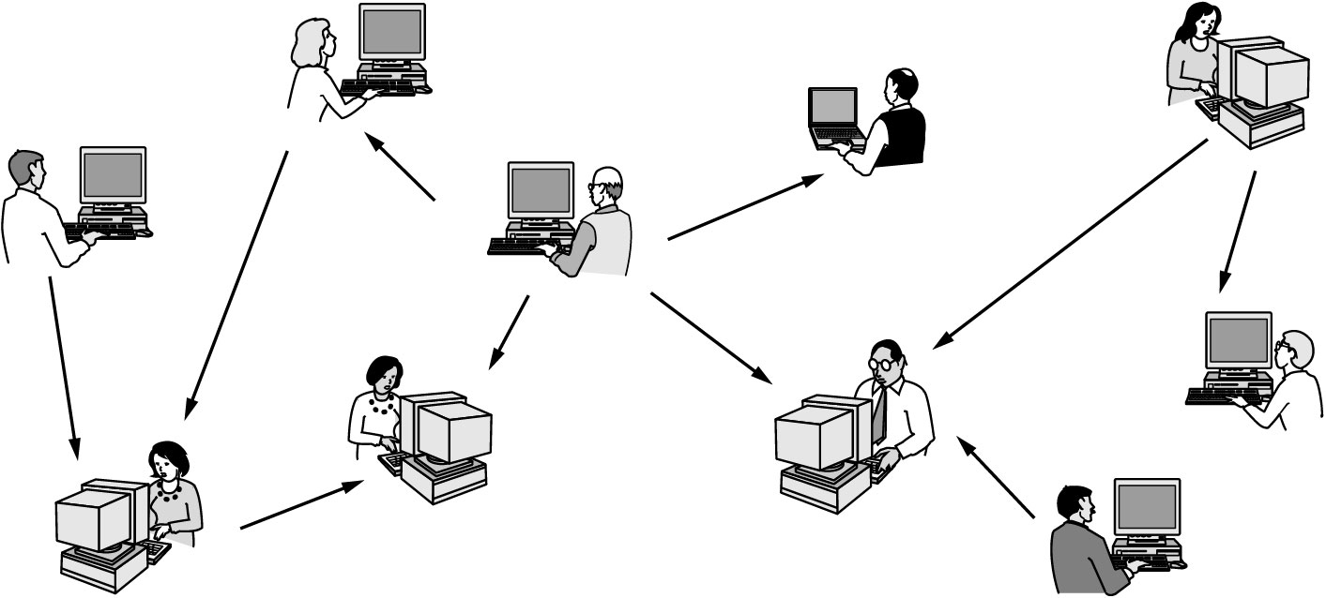
Home Network Applications (2)
In peer-to-peer system there are no fixed clients and servers.

Slide 40
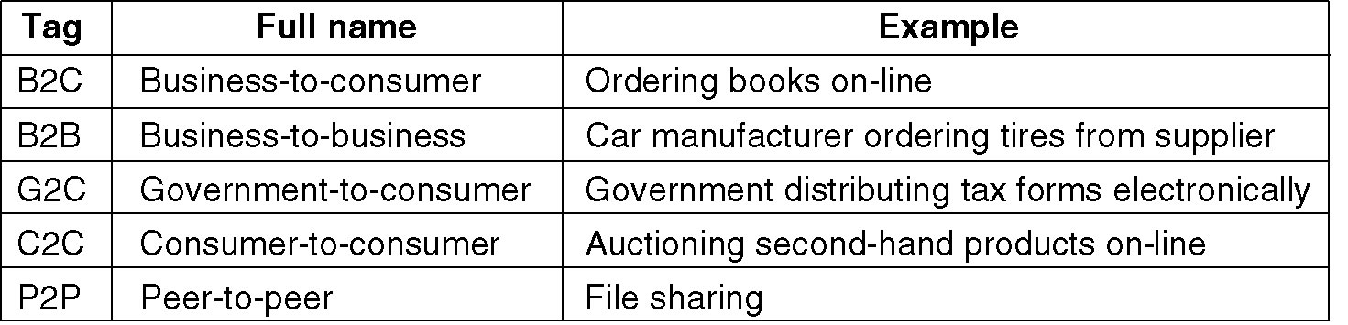
Home Network Applications (3)
Some forms of e-commerce.

Slide 41
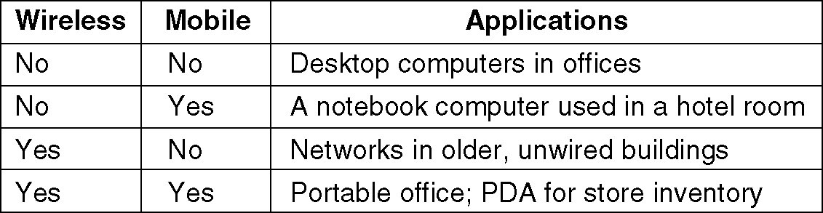
Mobile Network Users
Combinations of wireless networks and mobile computing.

Slide 42
Network Hardware
Local Area Networks
Metropolitan Area Networks
Wide Area Networks
Wireless Networks
Home Networks
Internetworks

Slide 43
Broadcast Networks
Types of transmission technology
Broadcast links
Point-to-point links

Slide 44
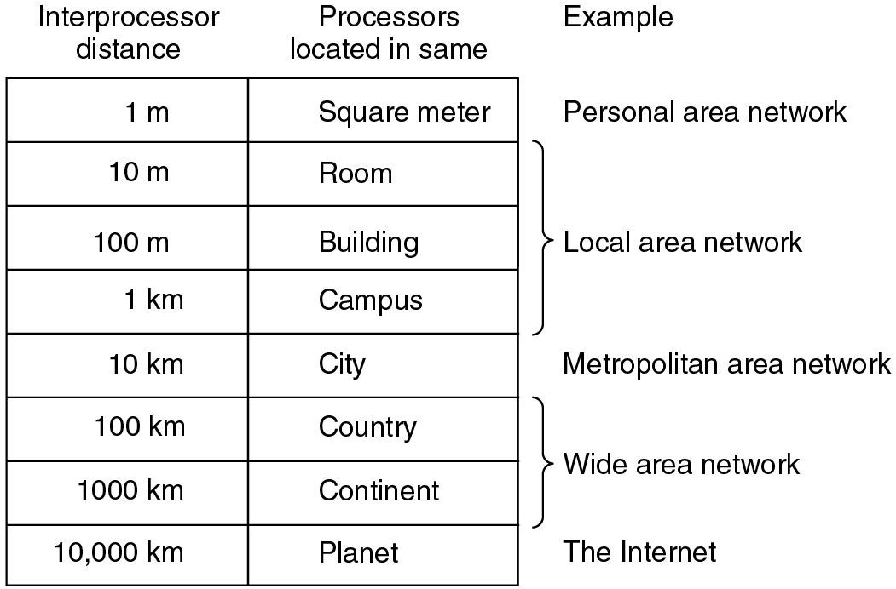
Broadcast Networks (2)
Classification of interconnected processors by scale.

Slide 45
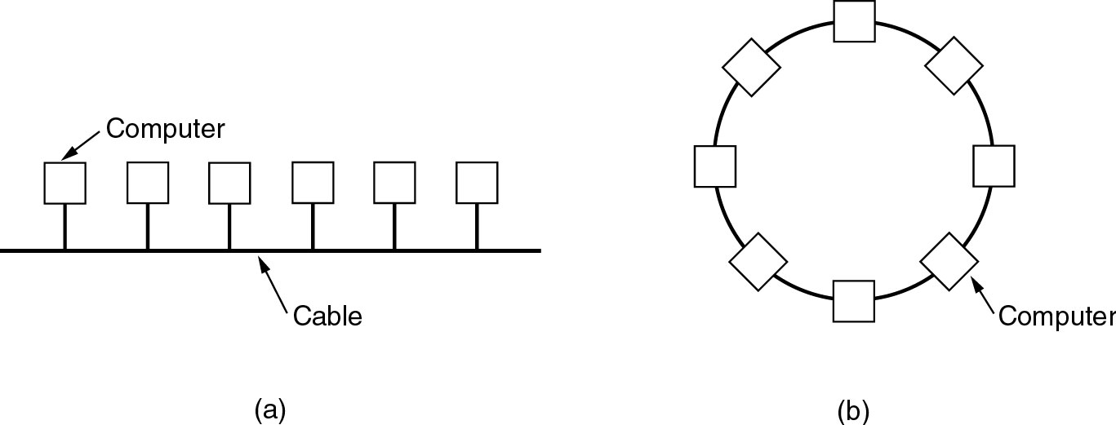
Local Area Networks
Two broadcast networks
(a) Bus
(b) Ring

Slide 46
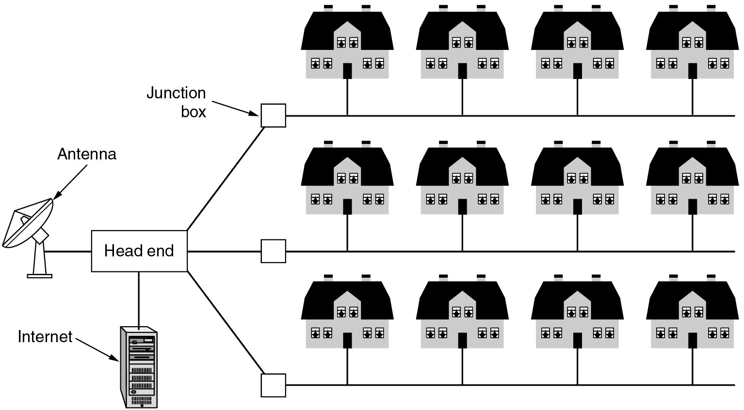
Metropolitan Area Networks
A metropolitan area network based on cable TV.

Slide 47
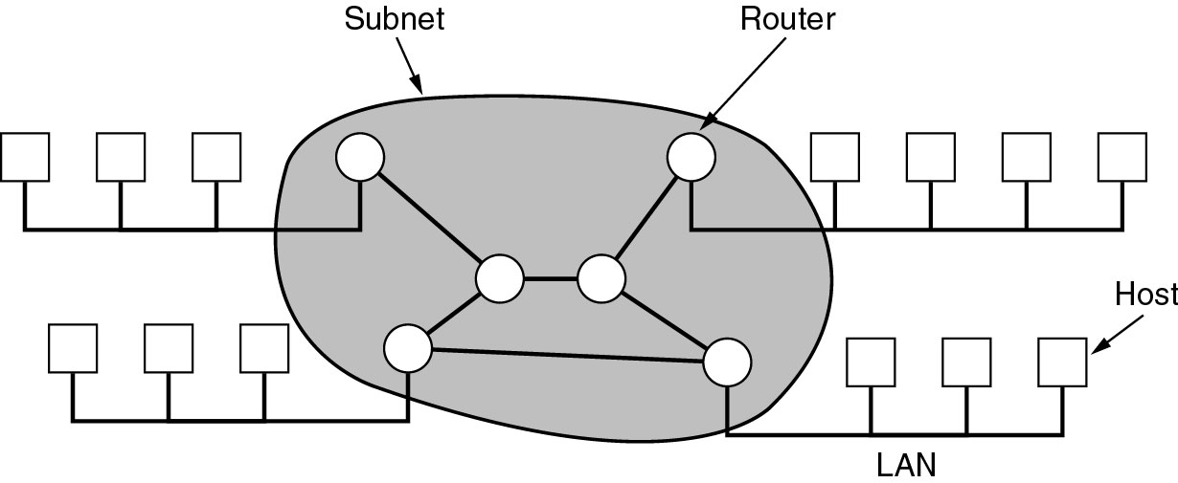
Wide Area Networks
Relation between hosts on LANs and the subnet.

Slide 48
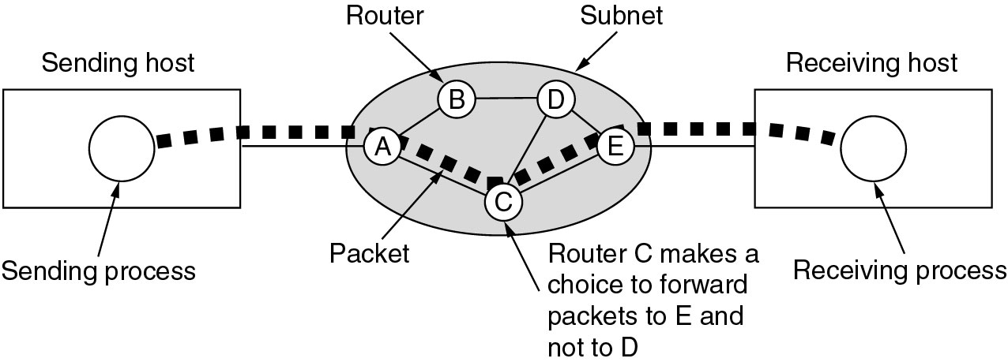
Wide Area Networks (2)
A stream of packets from sender to receiver.

Slide 49
Wireless Networks
Categories of wireless networks:
System interconnection
Wireless LANs
Wireless WANs

Slide 50
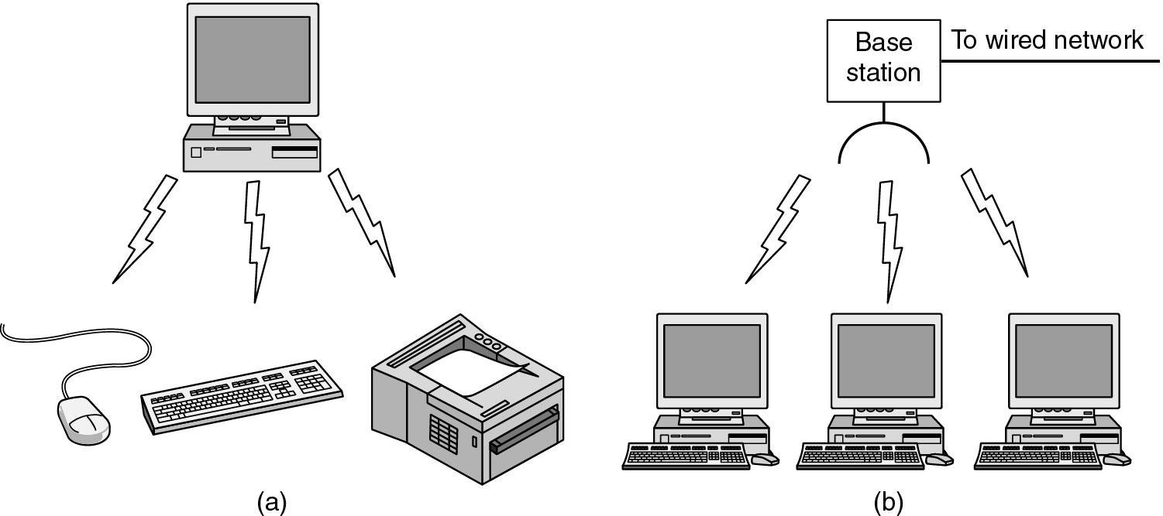
Wireless Networks (2)
(a) Bluetooth configuration
(b) Wireless LAN

Slide 51
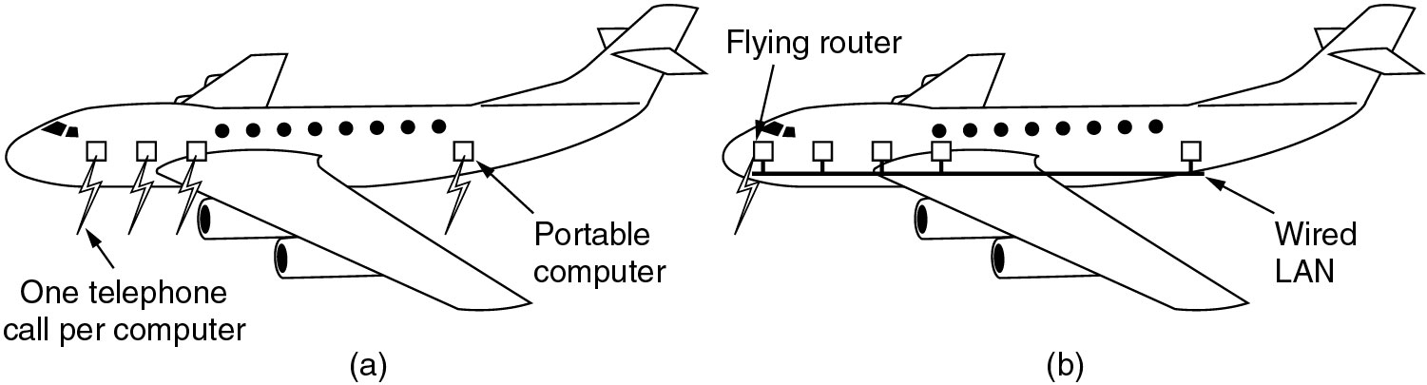
Wireless Networks (3)
(a) Individual mobile computers
(b) A flying LAN

Slide 52
Home Network Categories
Computers (desktop PC, PDA, shared peripherals
Entertainment (TV, DVD, VCR, camera, stereo, MP3)
Telecomm (telephone, cell phone, intercom, fax)
Appliances (microwave, fridge, clock, furnace, airco)
Telemetry (utility meter, burglar alarm, babycam).

Slide 53
Network Software
Protocol Hierarchies
Design Issues for the Layers
Connection-Oriented and Connectionless Services
Service Primitives
The Relationship of Services to Protocols

Slide 54
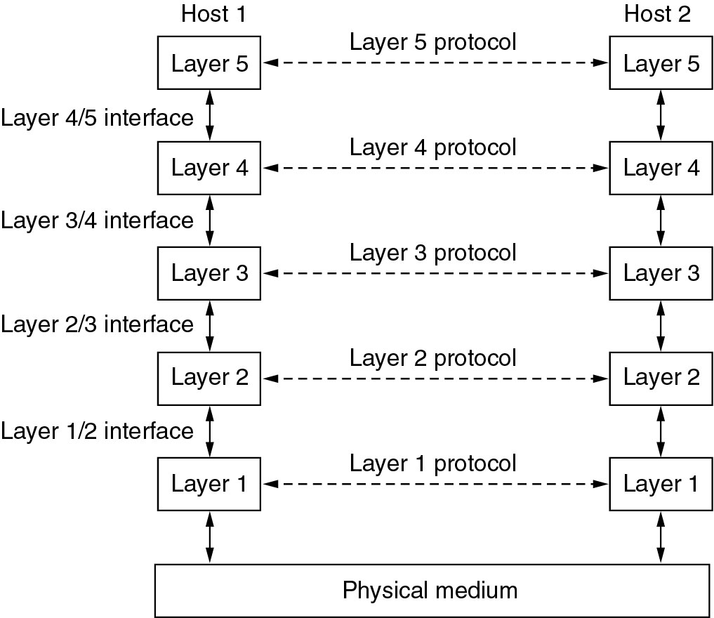
Network Software
Protocol Hierarchies
Layers, protocols, and interfaces.

Slide 55
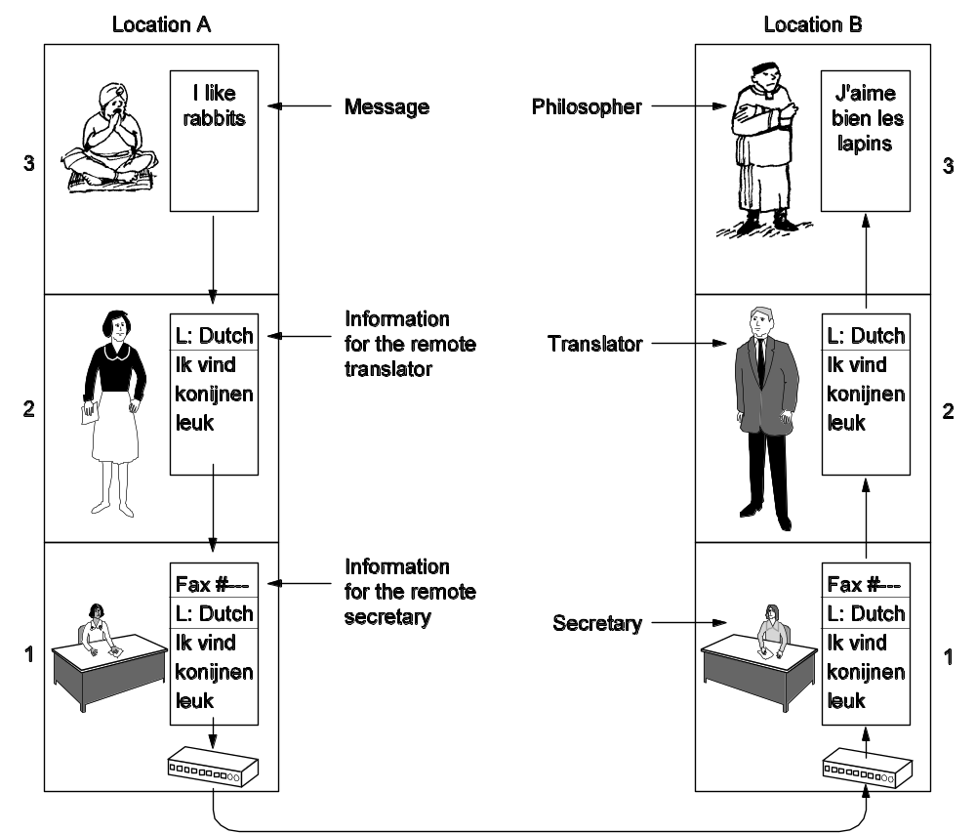
Protocol Hierarchies (2)
The philosopher-translator-secretary architecture.

Slide 56
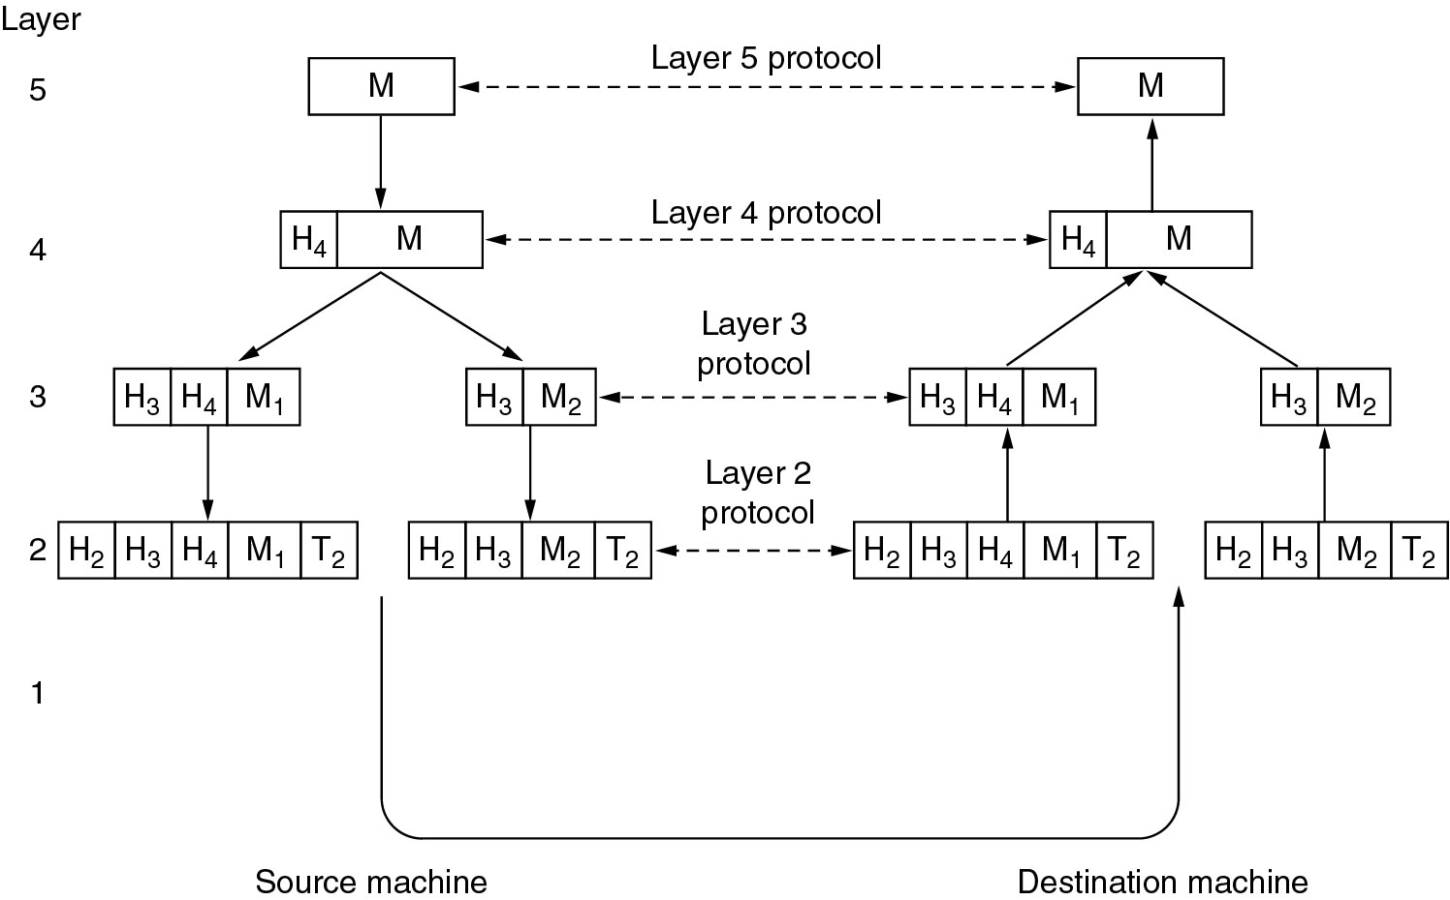
Protocol Hierarchies (3)
Example information flow supporting virtual communication in layer 5.

